Slide 1
Sizing, Positioning, and Transforming Elements

Slide 2
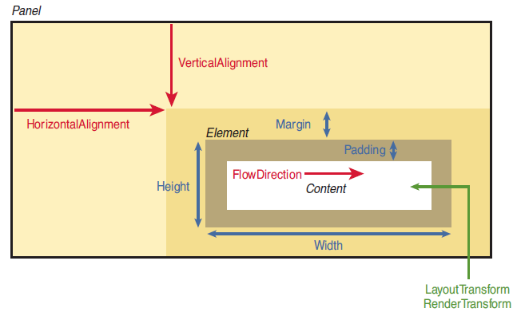
Notes:
Parent: System.Windows.Controls.Panel
Element: System.Windows.UIElement

Slide 3
Height and Width
MinHeight, MaxHeight, MinWidth, MaxWidth
DesiredSize (read-only)
Calculated during layout
RenderSize (read-only)
Final size of an element after layout is complete
ActualHeight, ActualWidth (read-only)
Equal to RenderSize.Height and RenderSize.Width
Notes:
Default: MinHeight = MinWidth = 0
MaxHeight = MaxWidth = Double.PositiveInfinity

Slide 4
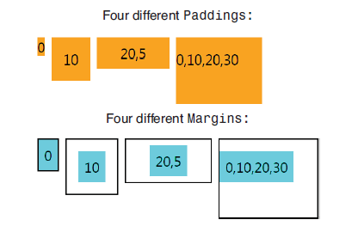
Margin and Padding
Notes:
Margin: extra space outside edges of the element, permits negative values
Padding: extra space inside edges of the element, does not allow negative values
Both are of type System.Windows.Thickness.

Slide 5
DIP
Device-Independent Pixels
1/96 inch, regardless of the screen’s DPI setting
96
On a typical 96-DPI display, 1 dip = 1 physical pixel

Slide 6
Control Position
Alignment
HorizontalAlignment
VerticalAlignment
Content Alignment
FlowDirection (explicitly set to match the current culture)

Slide 7
Applying Transforms
LayoutTransform (before the element is laid out)
RenderTransform (after the layout process has finished)
RotateTransform
ScaleTransform
SkewTransform
TranslateTransform
MatrixTransform
Not all FrameworkElements support transforms!
Notes:
Apply a transform to FrameworkElement NEVER changes the values of ActualHeight, ActualWidth, RenderSize.
ScaleTransform: affects only Padding, not Margin.
Using TransformGroup to combine transforms.

