Slide 1
WPF Fundamentals

Slide 2
Class Hierarchy
Object
Freezable
DispatcherObject
DependencyObject
Visual
Visual3D
ContentElement
UIElement
FrameworkElement
Control
UIElement3D
FrameworkContent
Element
Notes:
UIElement: support for routed events, command binding, layout and focus.
FrameworkElement: support for styles, data binding, resources, tooltips, context menus, etc.
Control: much more properties, such as Foreground, Background and Fontsize.

Slide 3
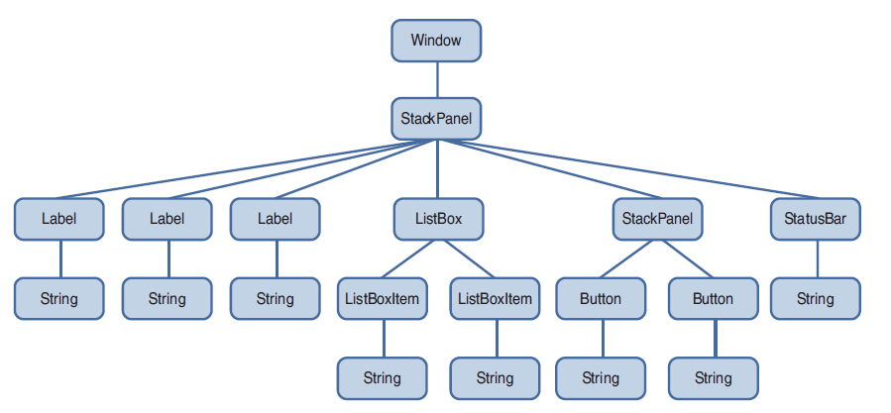
Logical Tree
Notes:
System.Windows.LogicalTreeHelper

Slide 4
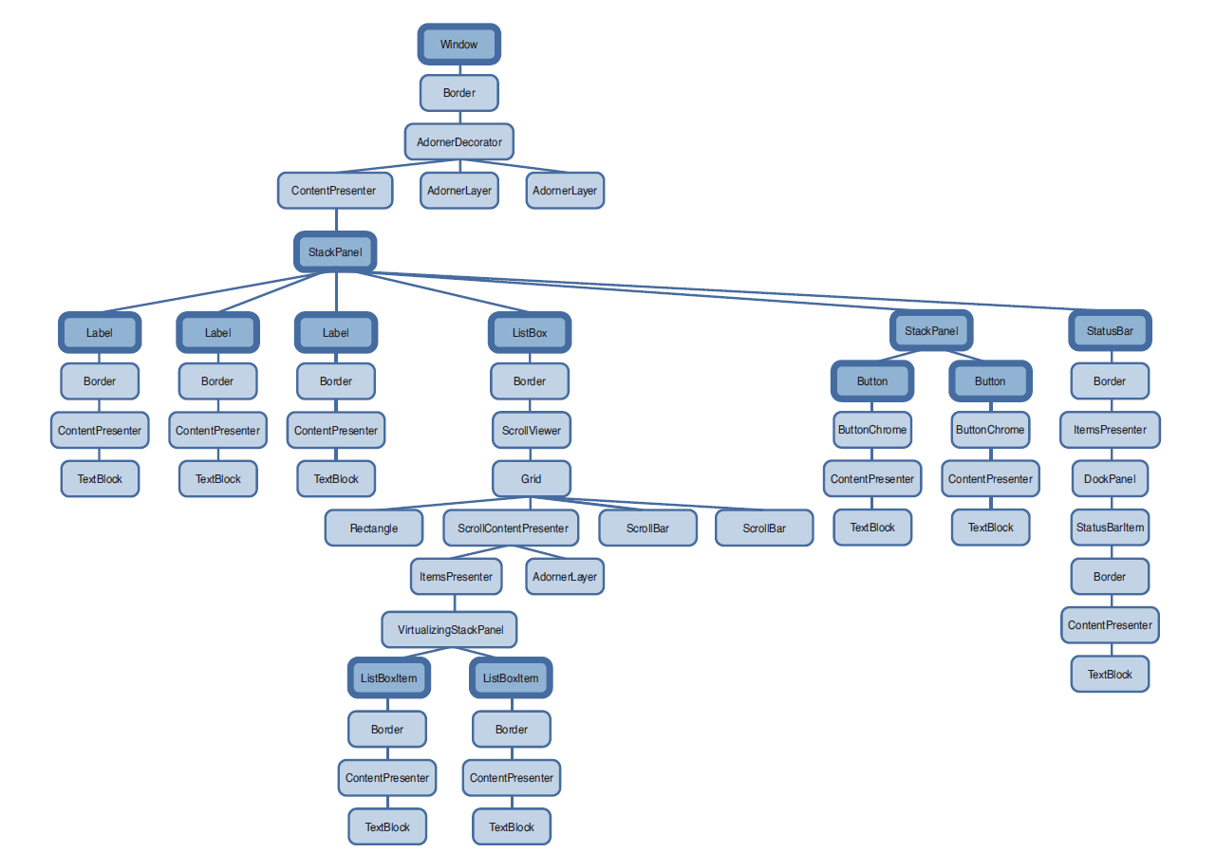
Visual Tree
Notes:
System.Windows.Media.VisualTreeHelper

Slide 5
Dependency Properties
Change notification
Property value inheritance
Support for multiple providers
  Determine the base value
  Evaluate (if an expression)
  Apply animations
  Coerce
  Validate
Notes:
Determine the base value: (highest -> lowest precedence) DependencyPropertyHelper.GetValueSource
Local value
Parent template trigger
Parent template
Style trigger
Template triggers
Style setters
Theme style triggers
Theme style setters
Property value inheritance
Default value

Slide 6
Attached Properties
DependencyProperty.RegisterAttached()
One of the ways in which WPF provides extensibility without the need for traditional inheritance

